Slide 1
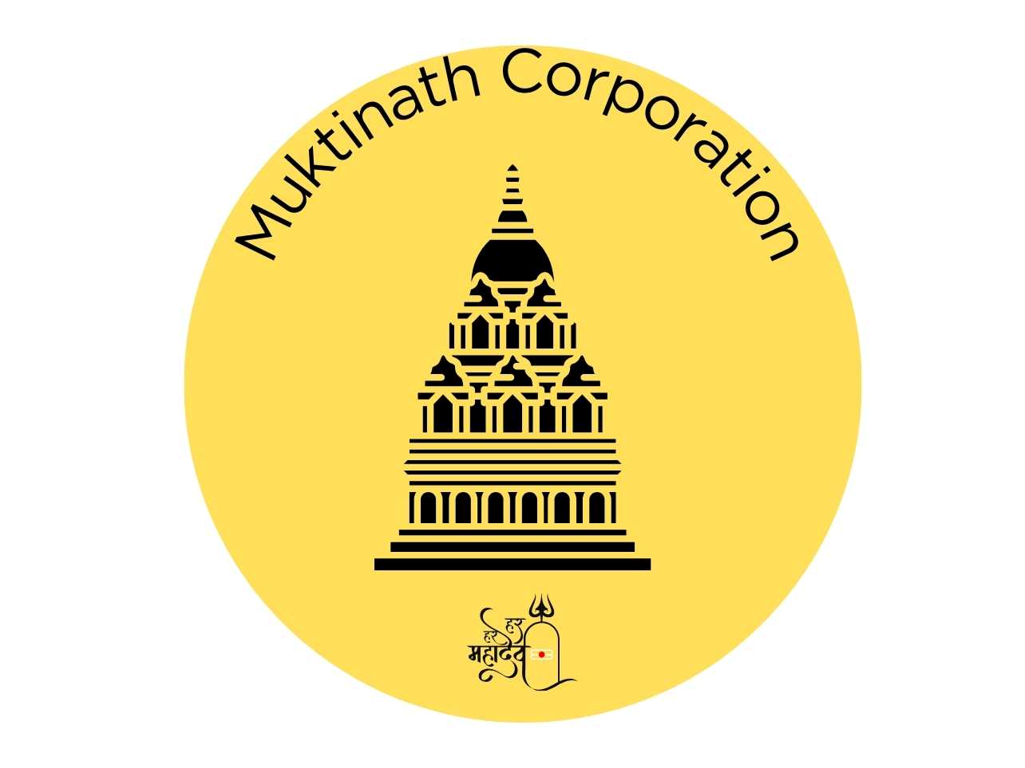
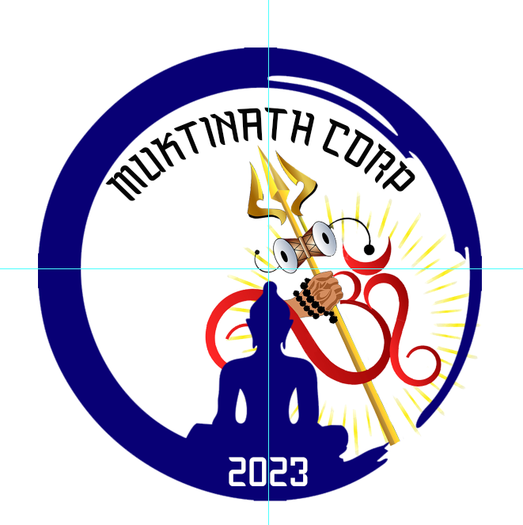
Muktinath Corporation
Logo Concept and Development Brief
By Abishek Gyawali
Logo Design Process:
The Brief
Design Principles
Background
Client Samples
Visual Research
Color Concept
Sketching and Conceptualizing
Final Design
Promotional Sample
BRIEF
Muktinath Corporation, a newly established Hindu temple (2023) in the Bay Area, seeks a simple and meaningful logo that reflects Hindu beliefs and fosters unity within the Nepali community. The logo will serve as a key element of brand identity for marketing and promotional purposes.
Design Principles
Simplicity : Clean and recognizable, avoiding unnecessary details.
Memorability: Unique and easy to recall.
Scalability: Versatile across different sizes and formats.
Proportion and Symmetry: Balanced and visually appealing.
Timelessness: Designed to endure, avoiding short-lived trends
BACKGROUND
The corporation team created few rough drafts of the graphic (logo) to convey their concept. They wanted to hire someone who can work on the concept and delver as needed.

Slide 2






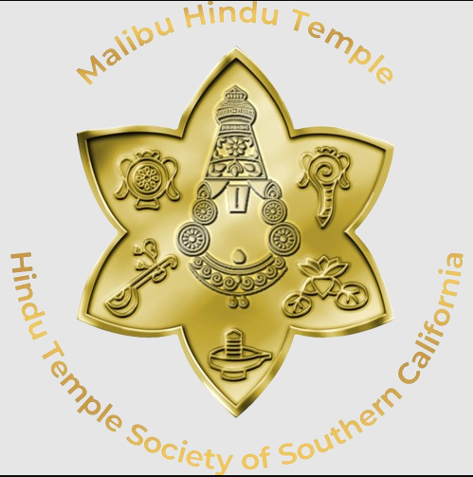



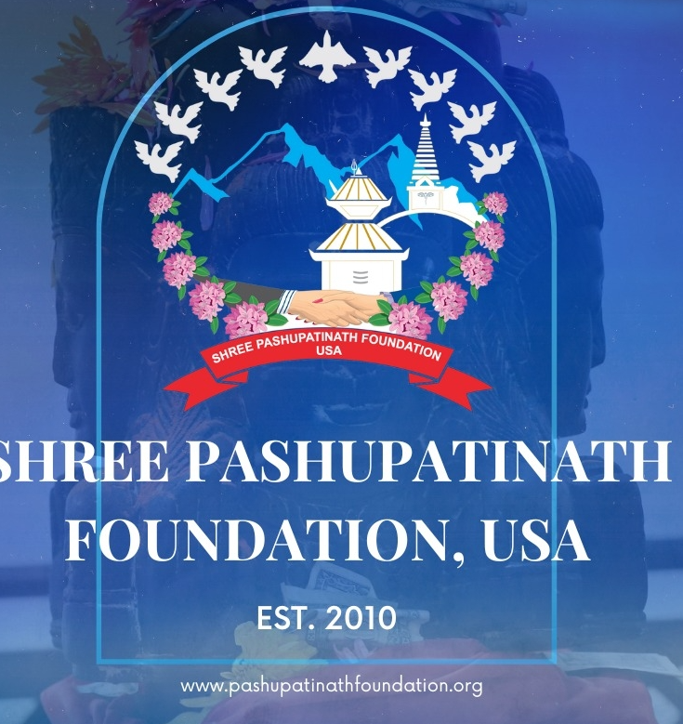
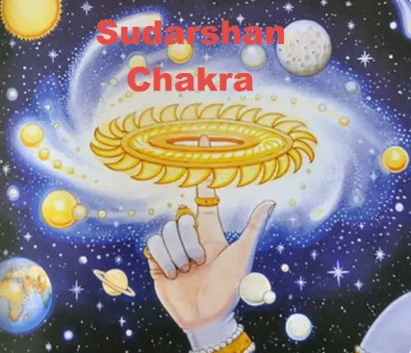
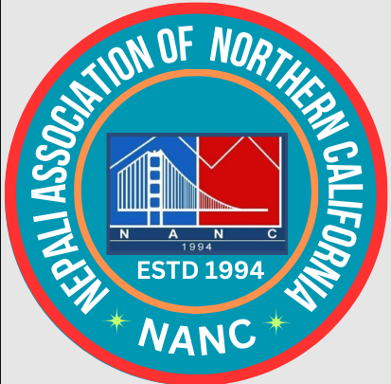

Muktinath Corporation
Logo Concept and Development Brief
By Abishek Gyawali
MOODBOARD
VISUAL RESEARCH
This mood board collects all the sample and logos of all Hindu temple around the world, the main idea is to make idea visual and express the message of unity among Nepalese community. Some of the designs were taken into consideration to communicate the final message.

Slide 3
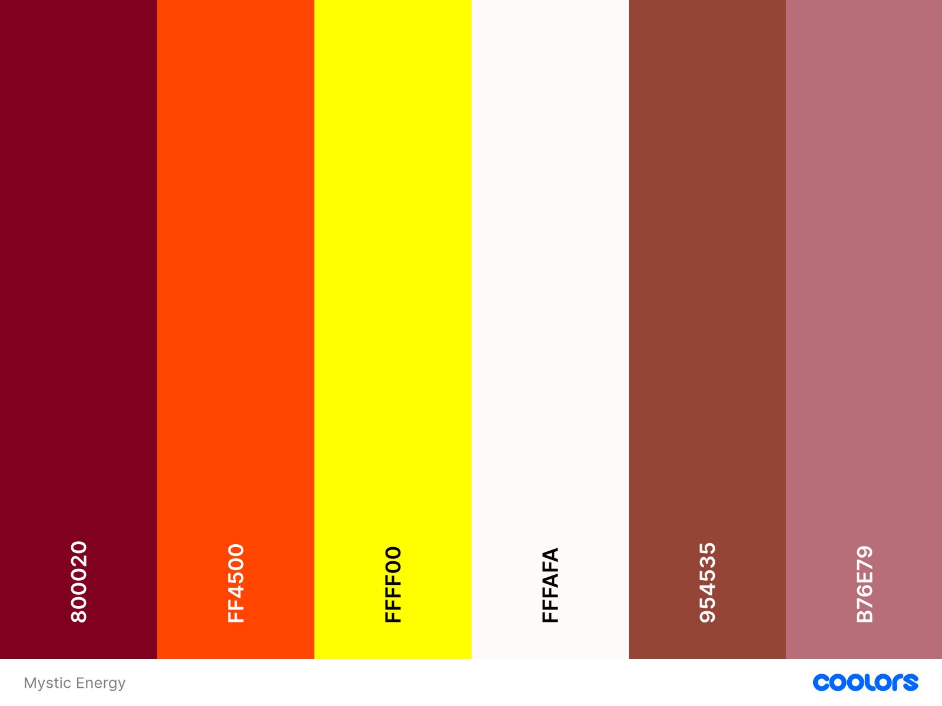
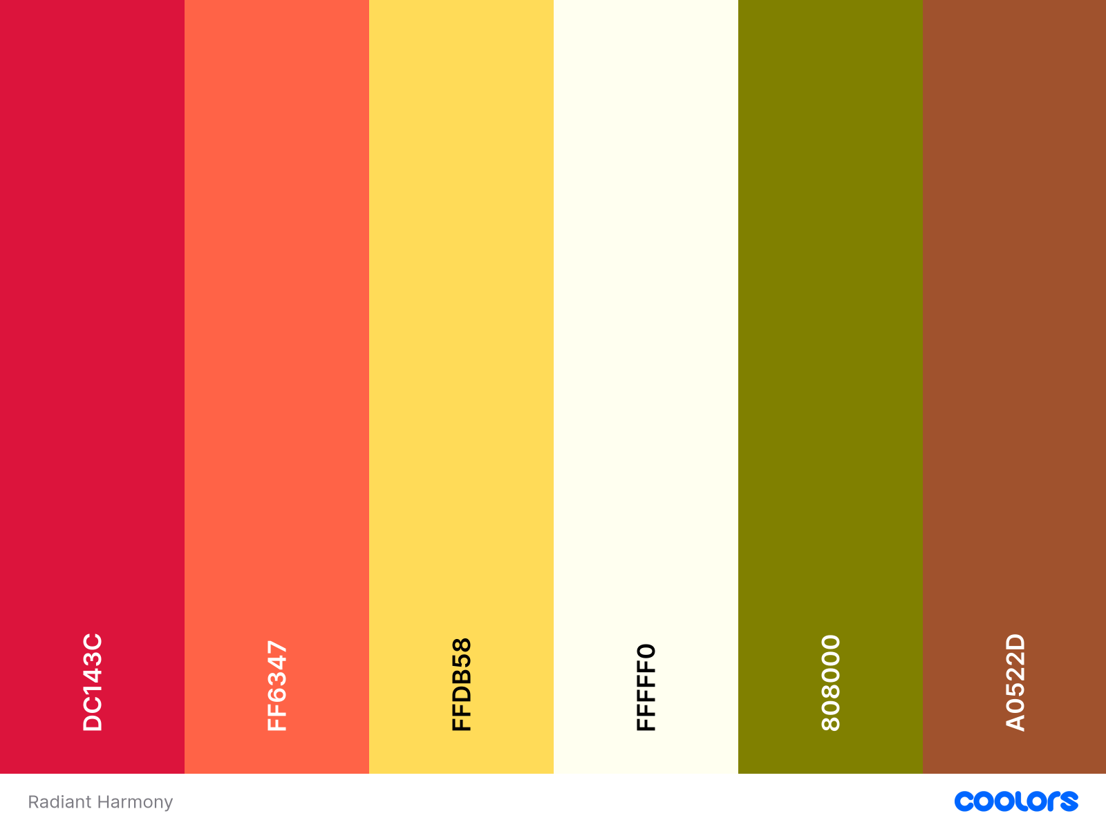
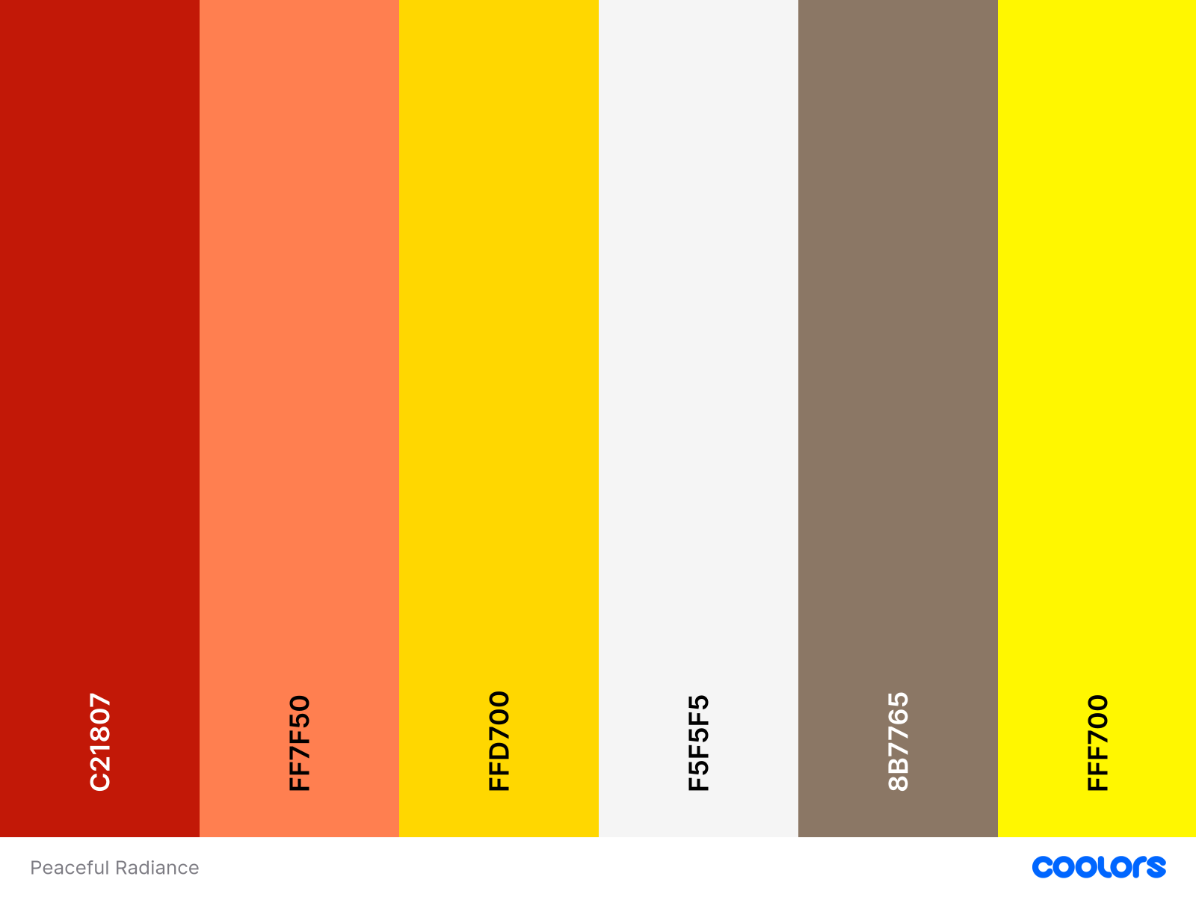
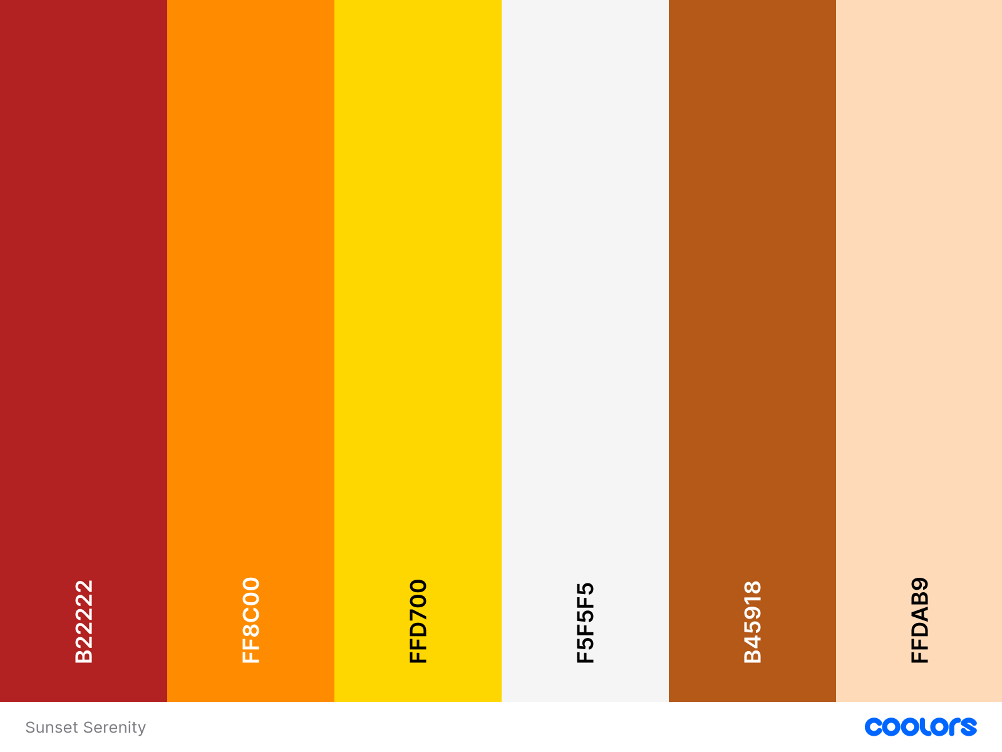
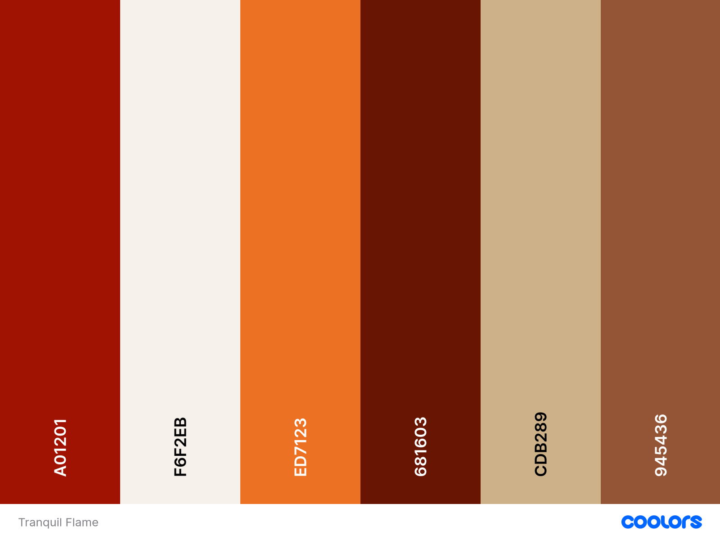
Muktinath Corporation
Logo Concept and Development Brief
By Abishek Gyawali
DESIGN PROCESS (Rough Version)
COLOR CONCEPT
These color pallets were selected which represents spirituality, energy, strength, peace and warmth in South Asian Cultures with more focus on Hindu Deity.

Slide 4


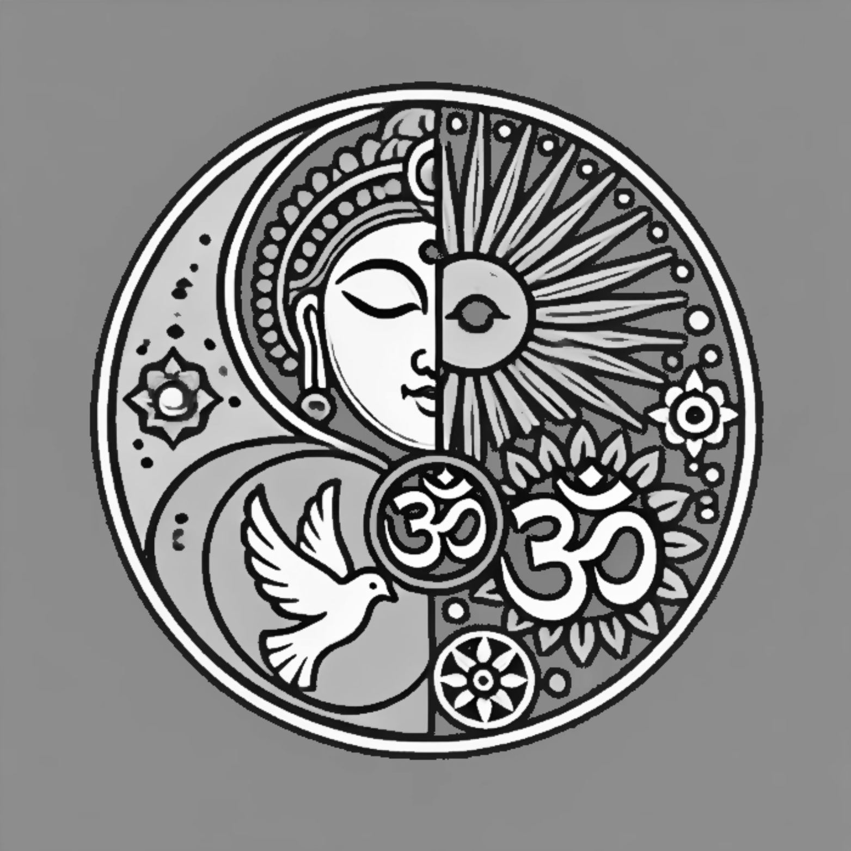
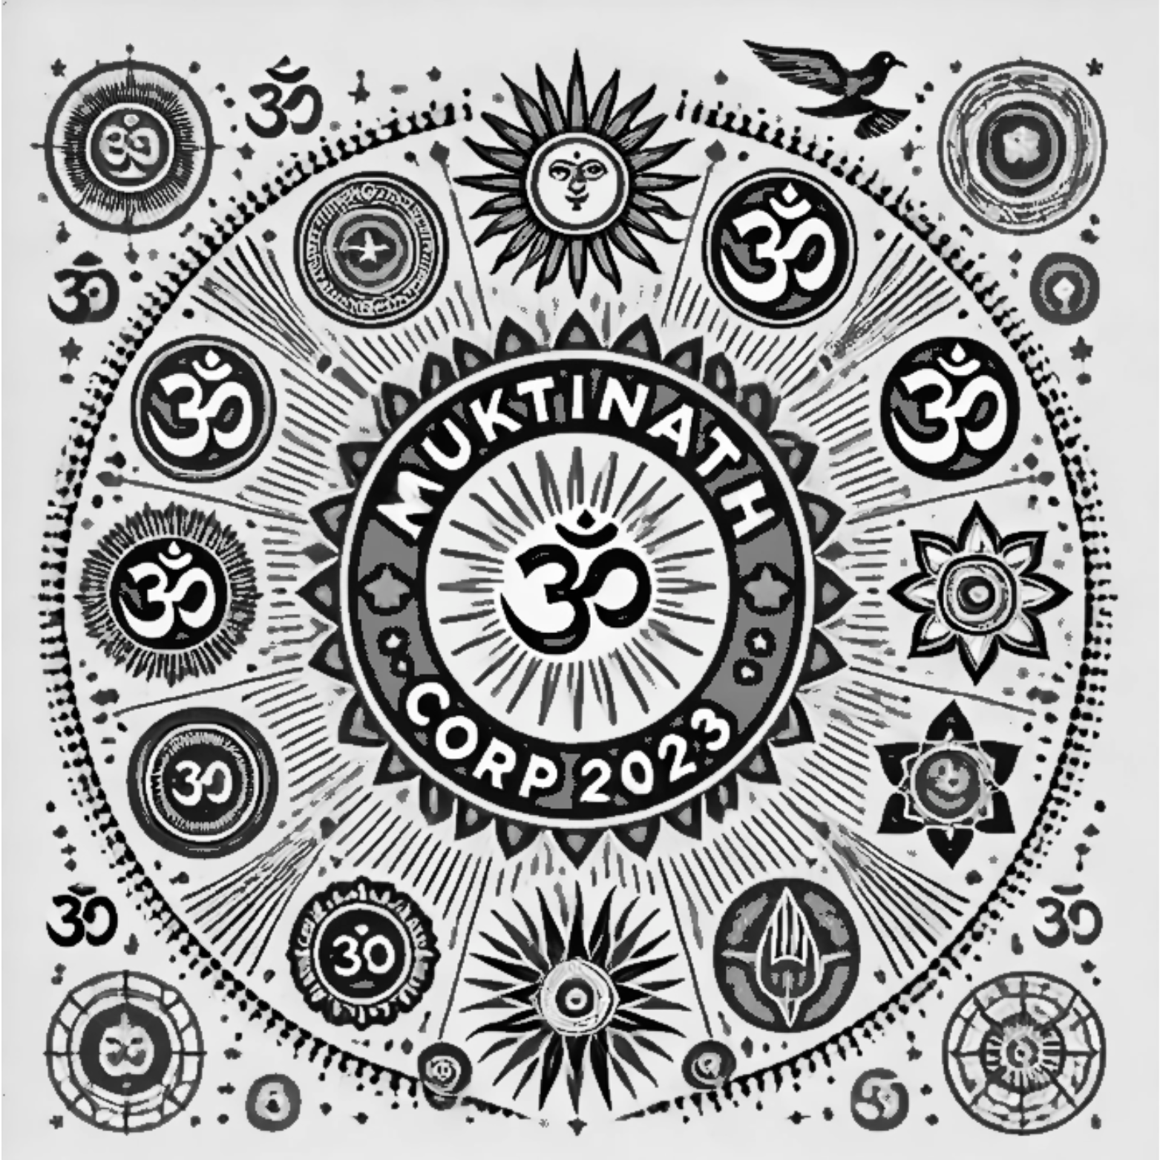
Muktinath Corporation
Logo Concept and Development Brief
By Abishek Gyawali
DESIGN PROCESS (Rough Version)
Sketching and Conceptualization
Thorough use of all the colors, shape, forms, I presented them 4 sketches samples of the graphic (logo) for Muktinath Corp. These logos were combination of pictorial mark and abstract mark
1
2
3
4

Slide 5


Muktinath Corporation
Logo Concept and Development Brief
By Abishek Gyawali
FINAL DESIGN
Selection by BOD of Muktinath Corp
After 2 months of sketching and presetting the logo, they said they will go for #2. They decided to go with Tranquil Flame color palette and Lato Bold Font which is as follows

Slide 6

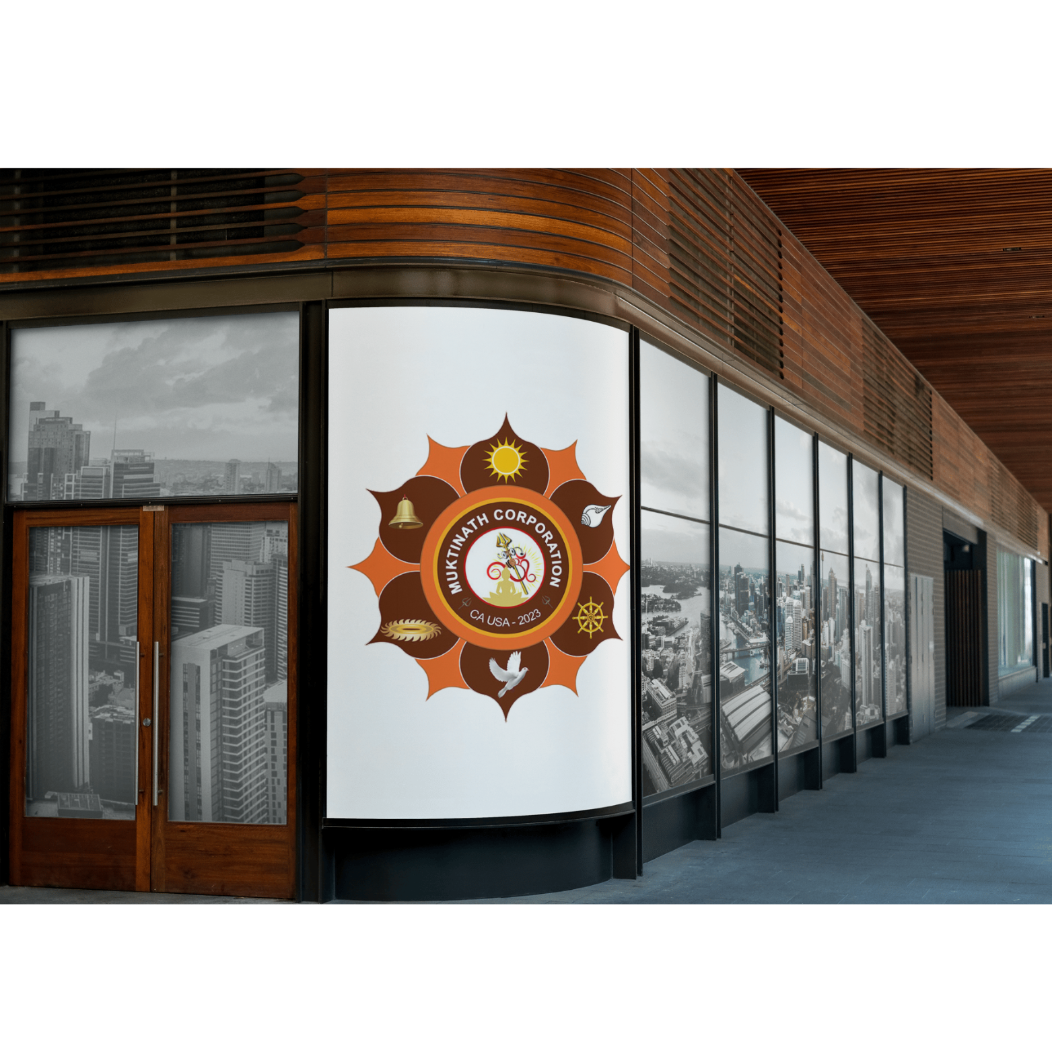
Muktinath Corporation
Logo Concept and Development Brief
By Abishek Gyawali
MOCKUPS
Promotional Items
This is how the logo will look when printed in different items which can be used for advertisement and branding purposes.

